Slide 1
New Sensors! Or Don’t Look at the Lasers!
BUT Don’t panic!
https://github.com/JimWright4089/FIRSTWorkshops

Slide 2
Intro
Things covered in this class:
Ports on the Hubs
Fantastic Beasts Sensors and Where to Find Them
The I2C Distance Sensor Code.

Slide 3

Thank you, Dryw Wade
Alumnus FTC Team 8923
Engineer at Sparkfun
CSA at the World Championship.
Wrote the walk through on I2C sensors with FTC

Slide 4
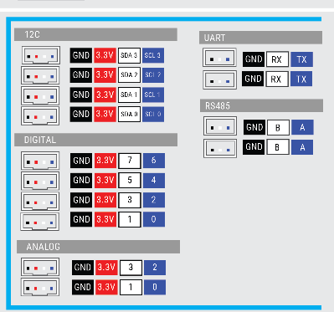
Hub Sensor Ports
https://github.com/JimWright4089/FIRSTWorkshops

Slide 5
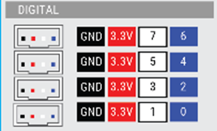
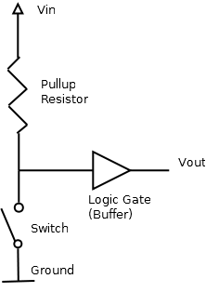
Digital Sensors
Eight per hub.
These are pulled up.
Connect them to Ground.
3.3V sensors, there is a boost board available if you need 5V.
+3.3V not really needed.
Very fast read

Slide 6
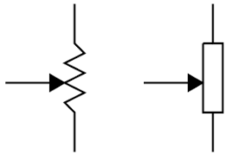
Analog Sensors
Four per hub.
Measure the amount of voltage into them.
3.3V sensors, there is a boost board available if you need 5V.
On a potentiometer connect +3.3v to one side and Gnd to other.

Slide 7
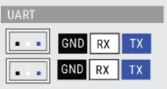
UART Ports
These are the most ancient communication ports in the world.
First used in 1959.
Two lines, Transmit and receive, both devices have to be communicating at the same speed called BAUD.
No guaranty the device is listening on the other end.

Slide 8
RS485 Ports
This was the main communication protocol on an airplane for a long while.
They act like a UART port, but can have multiple devices connected to it.
You will not find any sensors using this.
It’s used for the Hubs talking to each other.

Slide 9
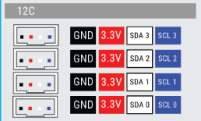
I2C Ports
This is the most useful port on the Hubs.
Lots of sensors use this.
Dryw has the write up for a temperture sensor here:
https://github.com/FIRST-Tech-Challenge/ftcrobotcontroller/wiki/Writing-an-I2C-Driver

Slide 10
I2C Ports
All four lines will be used
Clock line
Data line
Each port can handle 127-ish sensors connected to it.
Each Sensor has an address that you have to worry about.
Some sensors allow you to change the address.

Slide 11
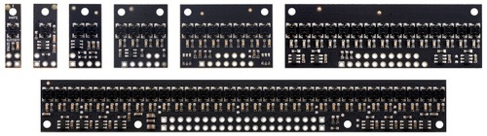
Black and White Line Sensors
Pololu has a good selection of these.
They only sense black and white.
You can use these like an optical limit switch.
Target has to be very close to sensor
Digital ports
https://github.com/JimWright4089/FIRSTWorkshops

Slide 12
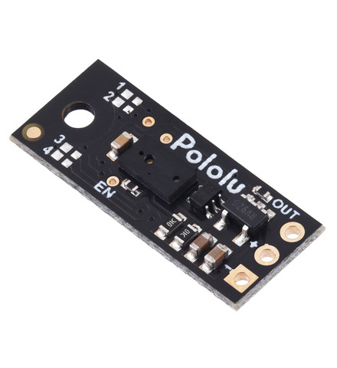
Pololu Digital Distance Sensors
They detect objects at a fixed distance.
5cm, 10cm, 25cm, 50cm, 100cm, 200cm.
If the target is closer than the range they will be a 1.
Farther away is a 0.
Digital ports
https://github.com/JimWright4089/FIRSTWorkshops

Slide 13
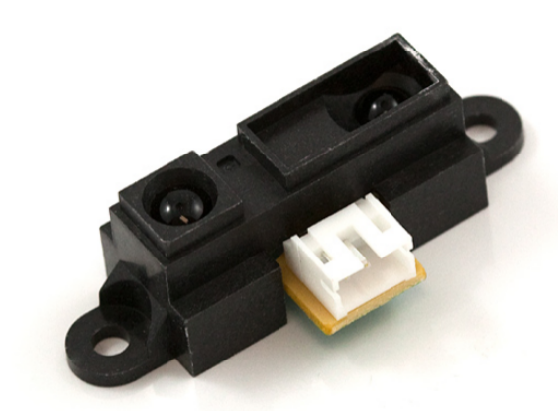
Sharp Distance Sensors
A very old sensor, used in touchless sinks.
This is an analog sensor.
The value larger the longer the target is away from the sensor.
Anything about 4 inches or closer are inverted, so put these 4 inches into the robot.
https://www.sparkfun.com/products/242
https://github.com/JimWright4089/FIRSTWorkshops

Slide 14
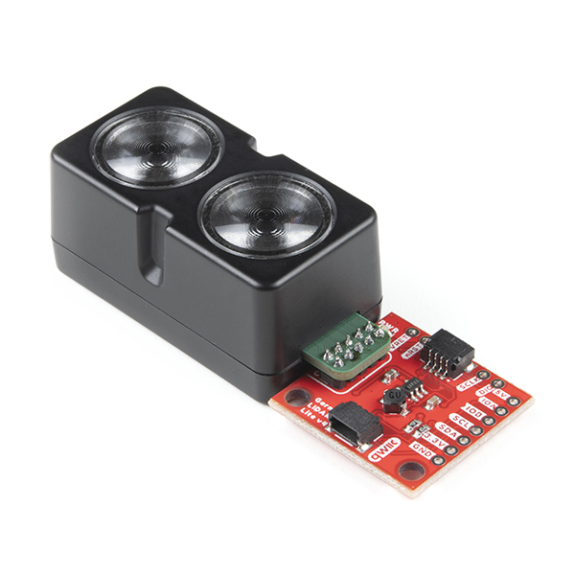
Garmin LIDAR-Lite v4 LED - Distance Measurement Sensor (Qwiic)
A range sensor with a 10m range and 1cm resolution.
I2C sensor that operates at 3.3v.
The address is programable so you can have multiple of these on the same port.
Default port 0x62
Qwiic connector, so chaining things is easy.
The sensor code later on uses this.
https://www.sparkfun.com/products/18009
https://github.com/JimWright4089/FIRSTWorkshops

Slide 15
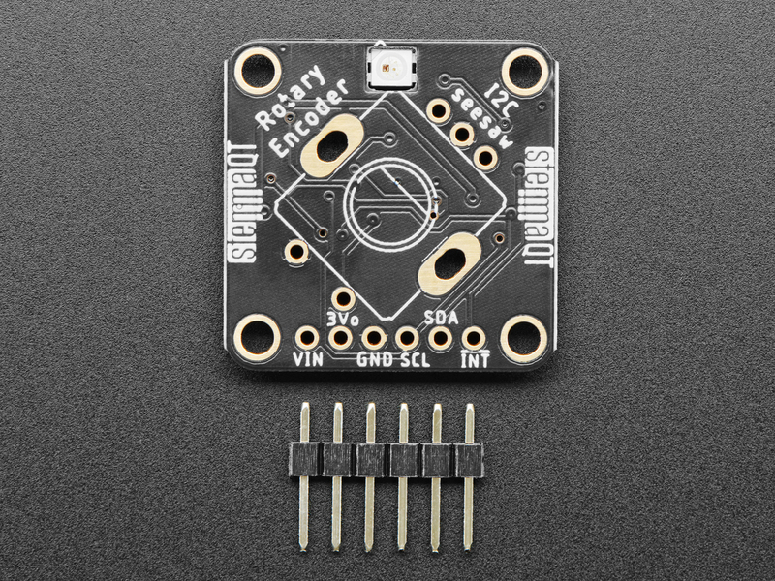
Adafruit I2C Stemma QT Rotary Encoder Breakout
We have four Encoders on each hub, but what if you need more encoders.
The Encoding is done on this board and you don’t need to do the processing on the hub.
Addresses from 0x36 to 0x3D
Using this is a bit advanced
https://www.adafruit.com/product/4991
https://github.com/JimWright4089/FIRSTWorkshops

Slide 16
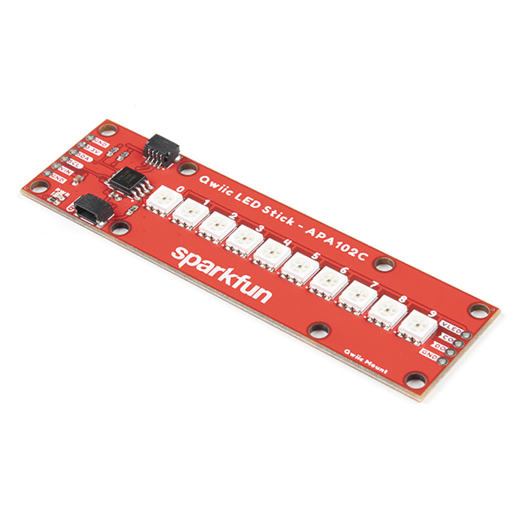
SparkFun Qwiic LED Stick - APA102C
Not a sensor, but useful.
I2C LED strip.
Runs on 3.3V!!!! Power just off the I2C port.
You can chain them to other things on the I2C port.
Address 0x23 or 0x22
Be careful of pulling to much current
https://www.sparkfun.com/products/18354
https://github.com/JimWright4089/FIRSTWorkshops

Slide 17
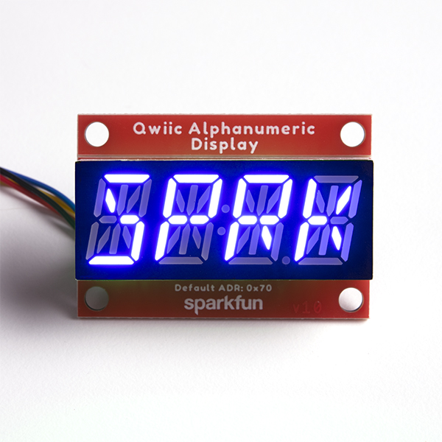
SparkFun Qwiic Alphanumeric Display
Also, not a sensor, but useful.
Thank your sponsors while playing!
There is a Red version and a Blue version, if you use the same address you can just swap them out each match.
You can chain them to other things on the I2C port.
Address 0x70, 0x71, 0x72 or 0x73
https://www.sparkfun.com/products/16917
https://github.com/JimWright4089/FIRSTWorkshops

Slide 18
Explore Sensors
These at only a sample of sensors out there.
Explore these sites for others.
https://www.pololu.com/
https://www.adafruit.com/
https://www.sparkfun.com
https://github.com/JimWright4089/FIRSTWorkshops

Slide 19

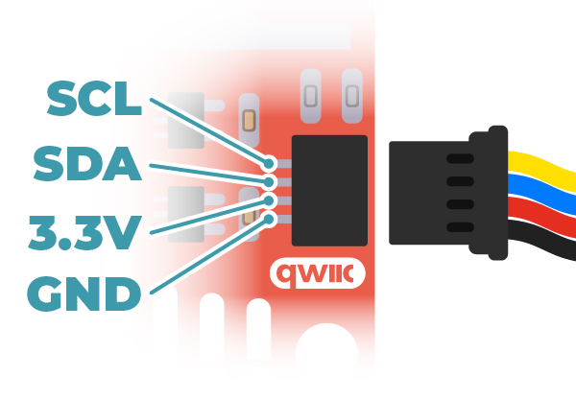
Example Driver and Using Lidar V4
The Lidar has Sparkfun Qwiic connectors on it and don’t plug into the hub ports.
Soldering up the cable.
Qwiic Yellow (clock) goes to Blue FTC
Qwiic Blue (data) goes to White FTC.
Black and Red go to Black and Red
https://github.com/JimWright4089/FIRSTWorkshops

Slide 20
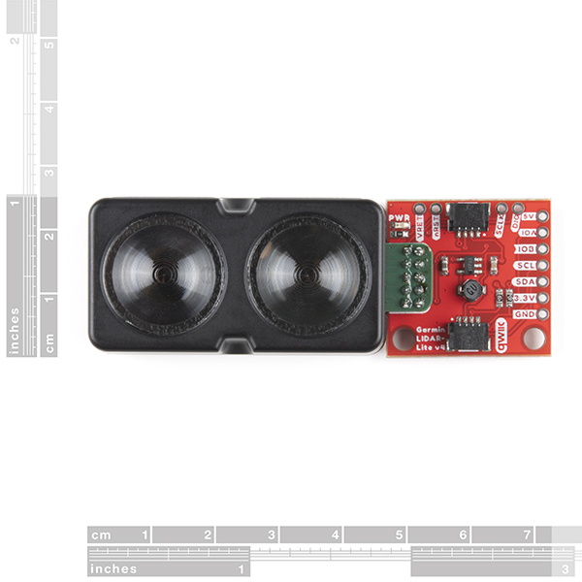
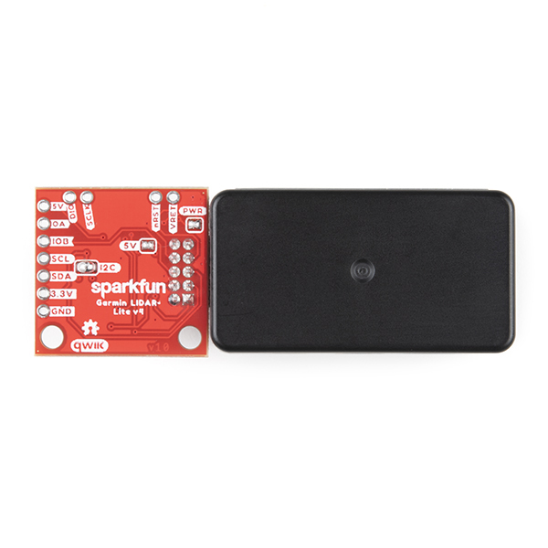
Cable Connection
I2C has pull up resisters on the Clock and Data.
Qwiic devices have these on the controller side.
FTC has these on the device side.
You have to worry about these resisters.
Sometimes the order of the chain matters
You can do this by soldering resisters into the pin holes on the sensor.
https://github.com/JimWright4089/FIRSTWorkshops

Slide 21
Custom Device
Every sensor you find has something called a Data Sheet.
The Data Sheet tells you critical information on the communication to it.
I2C communication has very small packets.
Getting and settings values is done with registers.
https://github.com/JimWright4089/FIRSTWorkshops

Slide 22
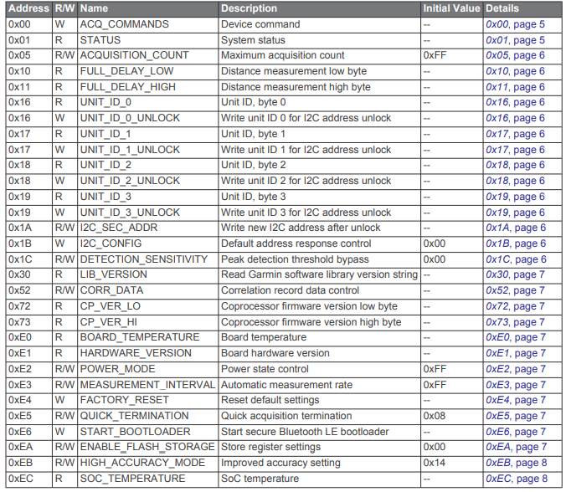
Registers for the Lidar V4
It has lots of registers
We will only use a few of them.
Some are sets or gets one or two bytes.
ACQ_COMMANDS(0x00),
STATUS(0x01),
FULL_DELAY_LOW(0x10),
FULL_DELAY_HIGH(0x11),
https://github.com/JimWright4089/FIRSTWorkshops

Slide 23
Custom Device Short cuts
Every sensor you find has an Ardiuno Driver and example.
Install the Ardiuno IDE and driver for the sensor.
The driver code is in C:\Users\Jim\Documents\Arduino\libraries\SparkFun_Garmin_LIDAR-Lite_v4_Arduino_Library\src
This code is written in C but that is very close to Java.
https://github.com/JimWright4089/FIRSTWorkshops

Slide 24
Reading a range
Write to the i2c ‘4’ to register ACQ_COMMANDS
Read the STATUS register that until the sensor is read
Read two bytes from register FULL_DELAY_LOW
Note the register FULL_DELAY_LOW is next to FULL_DELAY_HIGH
https://github.com/JimWright4089/FIRSTWorkshops

Slide 25
You need to add the device to the i2c list.
@I2cDeviceType
@DeviceProperties(name = "LIDARLiteV4 Sensor", description = "an LIDARLiteV4 sensor", xmlTag = "LIDARLiteV4")
When you compile the code with these lines, then reboot the device will appear in the I2C list when you config the robot.
https://github.com/JimWright4089/FIRSTWorkshops

Slide 26
Three methods you will need in the driver
@Override
protected synchronized boolean doInitialize()
@Override
public Manufacturer getManufacturer()
@Override
public String getDeviceName()
https://github.com/JimWright4089/FIRSTWorkshops

Slide 27
Troubleshooting
The pull up resisters will be you worse enemy
Re-arranging the devices with different pull up resisters.
Find a person with an oscilloscope that interprets I2C packets.
https://github.com/JimWright4089/FIRSTWorkshops

